Slide 1
Employee Data Analysis using Excel
STUDENT NAME: M.RIYA
REGISTER NO : 122204276/asunm1683122204276
DEPARTMENT : B.COM ( CORPORATE SECRETARYSHIP)
COLLEGE : GOVT ARTS AND SCIENCE COLLEGE
RK NAGAR CHENNAI-81
COLLEGE COGE : 1683

Slide 2
PROJECT TITLE
Employee Salary Analysis using Excel

Slide 3


AGENDA
Problem Statement
Project Overview
End Users
Our Solution and Proposition
Dataset Description
Modelling Approach
Results and Discussion
Conclusion
3/21/2024 Annual Review

Slide 4

PROBLEM STATEMENT
This project aims to provide a solution for recruiters who need help with determining appropriate salary ranges to offer candidates, as well as candidates who may need clarification about the salary ranges.

Slide 5

PROJECT OVERVIEW
This project aims to provide a solution for recruiters who need help with determining appropriate salary ranges to offer candidates, as well as candidates who may need clarification about the salary ranges.

Slide 6

WHO ARE THE END USERS?
Internal equity – Employers compare employees’ salary and indirect compensation data to ensure fair compensation for the level and type of work done.
Region – Employers compare compensation data of people doing similar work within a particular region.
Level – Employers compare employees’ levels and the level at which they are compensated.
:

Slide 7

OUR SOLUTION AND ITS VALUE PROPOSITION
vacation days
Work schedule or location
Stock option
Moving expenses
professional development

Slide 8
Dataset Description 1. Feature Engineering- Techniques 2. Outlier handling- appropriate strategy 3. Advanced clustering- Data structure 4. Modelling- Salary prediction 5. Evaluation- Performance skills

Slide 9

THE "WOW" IN OUR SOLUTION
Performance level=IRS
(HD=8,”VERY HIGH”,X7>4”HIGH”,
MED”,TRUE”LOW”)
3/21/2024 Annual Review
9

Slide 10
MODELLING
Step 1: access the data you need.
Step 2: identify spikes using historic data and national data.
Step 3: ask questions and investigate patterns and trends.
Plan your next steps.
10

Slide 11
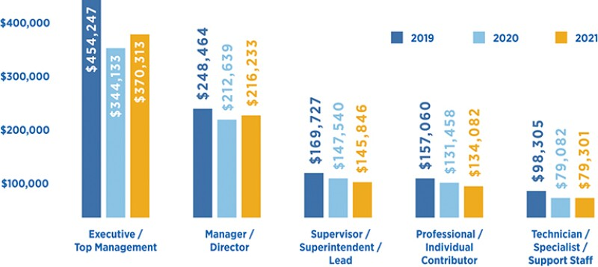
RESULTS
11

Slide 12
conclusion
*This information about your salary with colleagues has reasonable justification—too much information could cultivate an environment of envy or perceived injustice—but no information at all about how much one should earn results in plenty of confusion and unfairness as well. Both the employer and the employee gain from knowing more or less what the latter should make.
*Aside from the purpose of determining an appropriate salary offer or ask, the information in this report is also intended to help those in the design space navigate through the important career choices: which tasks might you want to spend more (or less) time on; which tools might you want to learn; and at which types of companies might you want to apply for a job. O

